Slide 1

Credit EDA Case StudY
By,
Shubham Khandelwal

Slide 2

Introduction
This case study aims to give us an idea of applying EDA in a real business scenario. In this case study, we develop a basic understanding of risk analytics in banking and financial services and understand how data is used to minimise the risk of losing money while lending to customers.

Slide 3
Business Understanding
The loan providing companies find it hard to give loans to the people due to their insufficient or non- existent credit history. Because of that, some consumers use it as their advantage by becoming a defaulter. Suppose you work for a consumer finance company which specialises in lending various types of loans to urban customers. You have to use EDA to analyse the patterns present in the data. This will ensure that the applicants are capable of repaying the loan are not rejected.
When the company receives a loan application, the company has to decide for loan approval based on the applicant’s profile. Two types of risks are associated with the bank’s decision (mentioned under slide: Problem Statement)
The data given below contains the information about the loan application at the time of applying for the
loan. It contains two types of scenarios:
The client with payment difficulties: he/she had late payment more than X days on at least one of the first Y instalments of the loan in our sample,
All other cases: All other cases when the payment is paid on time.

Slide 4

Business Understanding
When a client applies for a loan, there are four types of decisions that could be taken by the client/company):
Approved: The Company has approved loan Application
Cancelled: The client cancelled the application sometime during approval. Either the client changed her/his mind about the loan or in some cases due to a higher risk of the client he received worse pricing which he did not want.
Refused: The company had rejected the loan (because the client does not meet their requirements etc.).
Unused offer: Loan has been cancelled by the client but on different stages of the process.
Note: In this case study, we will use EDA to understand how consumer attributes and loan attributes influence the tendency of default.

Slide 5
Business Objectives
This case study aims to identify patterns which indicate if a client has difficulty paying their instalments which may be used for taking actions such as denying the loan, reducing the amount of loan, lending (to risky applicants) at a higher interest rate, etc. This will ensure that the consumers capable of repaying the loan are not rejected. Identification of such applicants using EDA is the aim of this case study.
In other words, the company wants to understand the driving factors (or driver variables) behind loan default, i.e. the variables which are strong indicators of default. The company can utilise this knowledge for its portfolio and risk assessment.To develop your understanding of the domain, you are advised to independently research a little about risk analytics - understanding the types of variables and their significance should be enough).

Slide 6
Problem Statement
A consumer finance company specializes in lending various types of loans to urban customers. When the company receives a loan application, the company has to make a decision for loan approval based on the applicant’s profile.
Two types of risks are associated with the bank’s decision:
If the applicant is likely to repay the loan, then not approving the loan results in a loss
of business to the company
If the applicant is not likely to repay the loan, i.e. he/she is likely to default, then approving the loan may lead to a financial loss for the company
The company wants to understand the driving factors (or driver variables) behind loan default, i.e. the variables which are strong indicators of default. The company can utilize this knowledge for its portfolio and risk assessment.

Slide 7

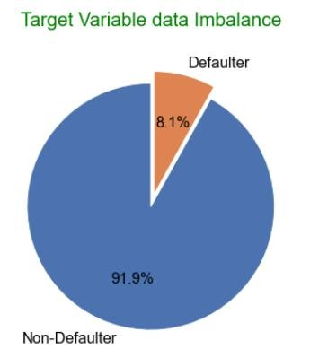
Data Imbalance
Ratios of imbalance for Non-Defaulter and Defaulter in Percentage is: 91.93 and 8.07
Ratios of imbalance for Non-Defaulter Vs Defaulter is:
11.39 :1 (approx.)

Slide 8
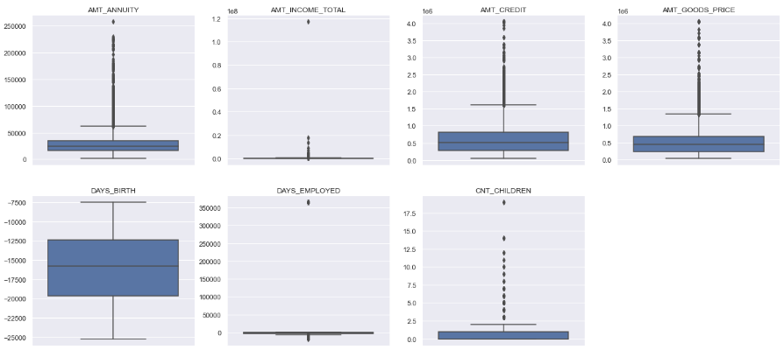
Outlier analysis
AMT_ANNUITY, AMT_CREDIT, AMT_GOODS_PRICE,CNT_CHILDR EN have some number of outliers.
AMT_INCOME_TOTAL has huge number of outliers which indicate that few of the loan applicants have high income when compared to the others.
DAYS_BIRTH has no outliers which means the data available is reliable.
DAYS_EMPLOYED has outlier values around 350000(days) which is around 958 years which is impossible and hence this has to be incorrect entry.

Slide 9
Univariate Analysis For Categorical Variables For Both 0 And 1

Slide 10
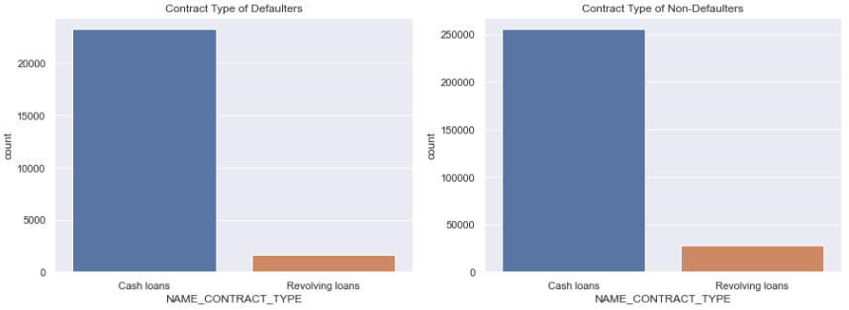
Plotting Countplot based on Contract Type
Points to be concluded from the graph on the left.
- Number of Cash loans are higher in both default/ non- default cases than Revolving loans, while revolving loan are approx 10% of total loans

Slide 11
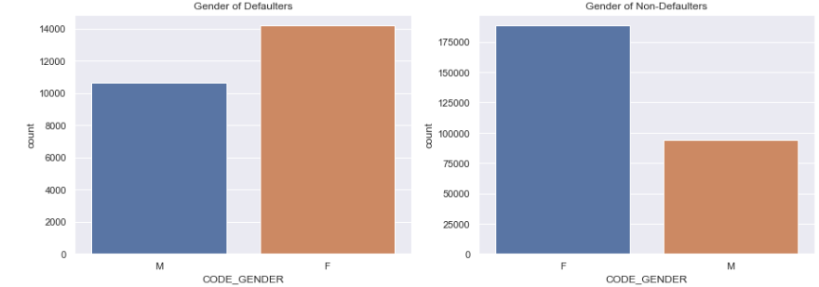
Plotting Countplot based on Gender Type
Points to be concluded from
the graph on the left.
Number of Female clients are more in both the cases default/non-default.
The number of female clients is almost double the number of male clients.
Based on the defaulted credits, males have a higher chance of not returning their loans, comparing with women .

Slide 12
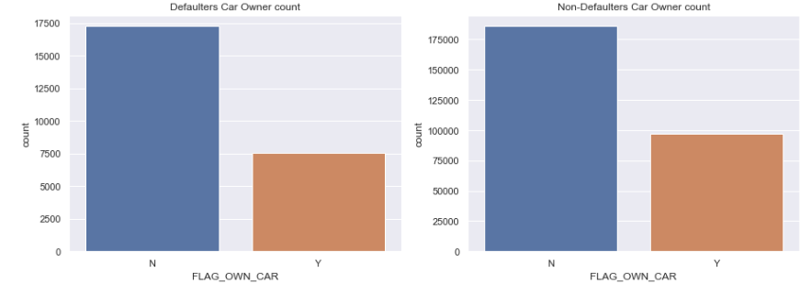
Plotting Countplot based on Car own status
Points to be concluded from the graph on the left.
Defalut/Non-default both the cases, the count of client who do not own car is higher than who owns a car.
But based on the percentage of default, there is no correlation between owning a car and loan repayment as in both cases the default percentage is almost same.

Slide 13
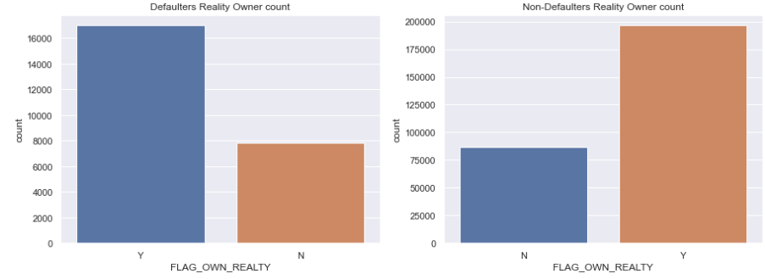
Plotting Countplot based on flat own status
Points to be concluded from the graph on the left.
Defalut/Non-default both the cases, the count of client who do own real estate is higher than who has not.
The clients who own real estate are more than double of the ones that don't own.
But the defaulting rate of both categories are around the same. Thus there is no correlation between owning a reality and defaulting the loan.

Slide 14
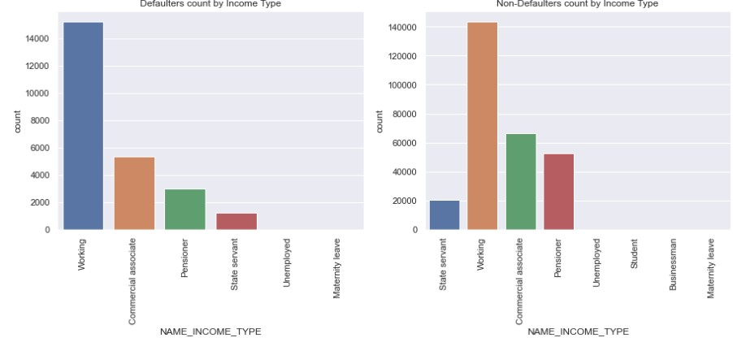
Plotting Countplot based on Income type status
Points to be concluded from the graph on the left
In case of defaulters
Working class has highest number of credits compared to unemployed
/ maternity leave which is nil
In case of non-defaulters
Working class has highest number
of credits compared to unemployed
/ maternity leave/ student/ businessman which is nil
Majority of the applicants are from working, commercial associate, pensioners and state servants. The remaining categories of income types are very small

Slide 15
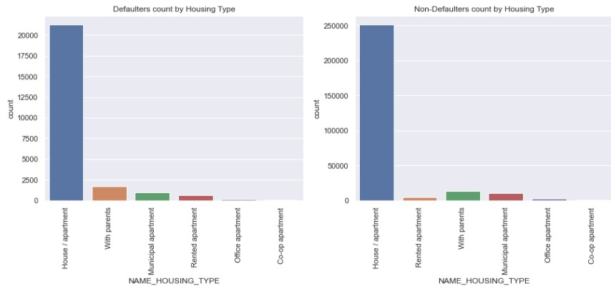
Plotting Countplot based on Housing type
Points to be concluded from the graph on the left
Regardless of Defaulters / Non- Defaulters majority of people live in house/apartment
People living in office apartments / co-op apartment have lowest default rate

Slide 16
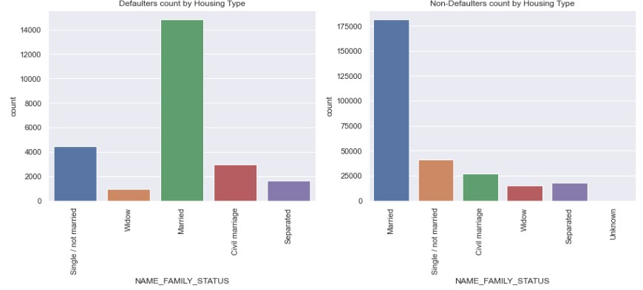
Plotting Countplot based on Family Status
Points to be concluded from the graph on the left
Most of the people who have taken loan are married, followed by Single/not married and civil marriage
In terms of percentage of not repayment of loan, Married is highest , with Widow the lowest.

Slide 17
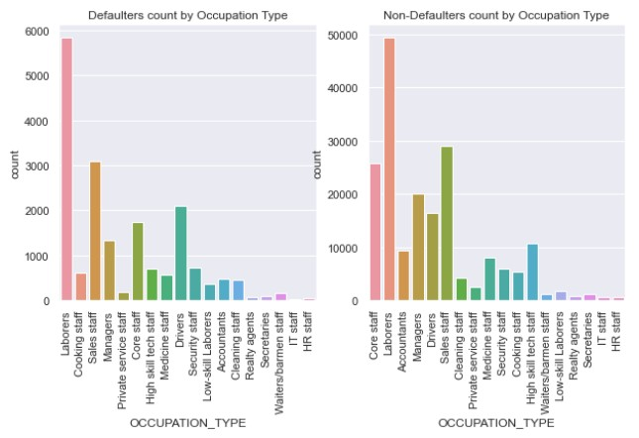
Plotting Countplot based on Occupation type
Points to be concluded from the graph on the left.
Most of the loans are taken by people whose Occupation is "Missing" in the dataset followed by Laborers, Sales staff. IT staff take the lowest amount of loans.
The category with highest percent of not repaid loans are Low-skill Laborers (above 17%), followed by Drivers and Waiters/barmen staff, Security staff, Laborers and Cooking staff

Slide 18
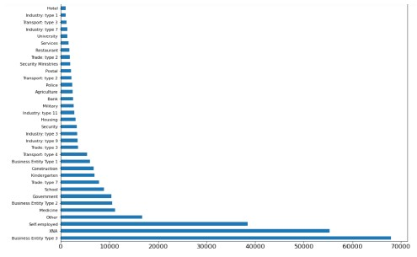
Plotting Countplot based on Organization Type
Points to be concluded from the graph on the left
Most of the applications for loan are from people working in Business Entity Type 3 organization
Organizations with highest percent of loans not repaid are Transport: type 3 (around 16%), Industry: type 13 (13.5%), Industry: type 8 (around 12.5%) and Restaurant (less than 12%).
Self employed people have relative high defaulting rate (10%), and thus should be thoughly scrutized before being approved for loan or provide loan with higher interest rate to mitigate the risk of defaulting.
For a very high number of applications, Organization type information is unavailable(XNA)
It can be seen that following category of organization type has lesser defaulters thus safer for providing loans:
Trade Type 4
Industry type 12

Slide 19
Univariate Analysis For Continuous Variables For Both 0 And 1

Slide 20
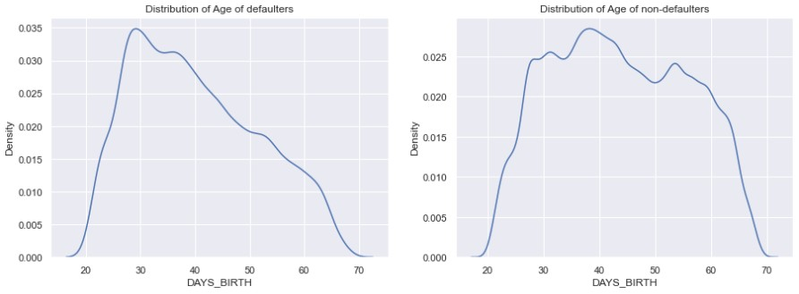
Plotting Distplot for Days Birth
Points to be concluded from the graph on the left.
- It can be observed that around 29 years to 40 years people are more defaulters. There is high chance of the young group to be deafulters.

Slide 21
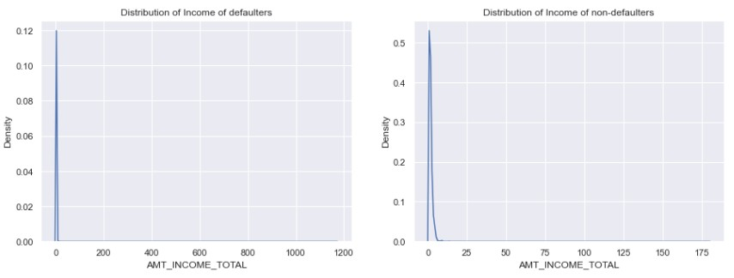
Plotting Distplot for Total Income
Points to be concluded from the graph on the left.
There are interesting patterns in both the default and non- default people with respect to Income Total.
From upto 1,00,000 income has some spikes and then higher the income, the lesser spike we can see for default people.
However, the pattern is same for both the default and non- default. The frequency range of non-default people is larger than default

Slide 22
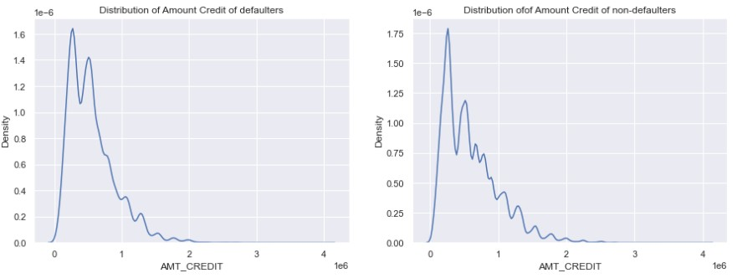
Plotting Distplot for Credit Amount
Points to be concluded from
the graph on the left.
- It can be inferred from the graph that lesser the loan credit amount, the higher the default chances.

Slide 23
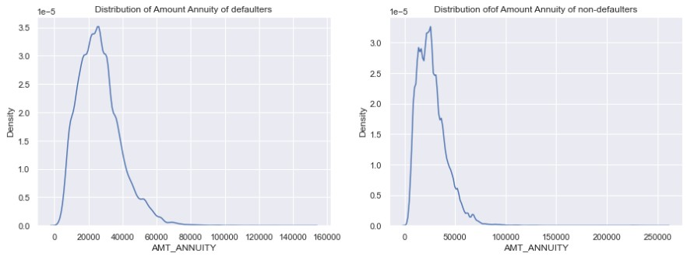
Plotting Distplot for Annuity Amount
Points to be concluded from the graph on the left.
- Here also we can see the same pattern in both the default and non-default. The loan annuty is mostly concentrated within 10,000 to 40,000 range in both the cases.

Slide 24
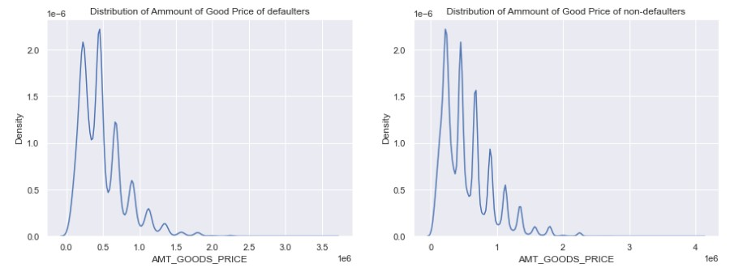
Plotting of Distplot for Good Price Amount
Points to be concluded from the graph on the left.
- We can see huge spikes from 1,00,000 to 5,00,000, then
around 5,00,000 price. At this
range people are more defaulted and higher the goods price, people are becoming the less defaulted. We can infer that, rich people are buying costly product and thus they are becoming less defaulted.

Slide 25
Correlation for numerical columns for both the cases, i.e. 0 and 1

Slide 26
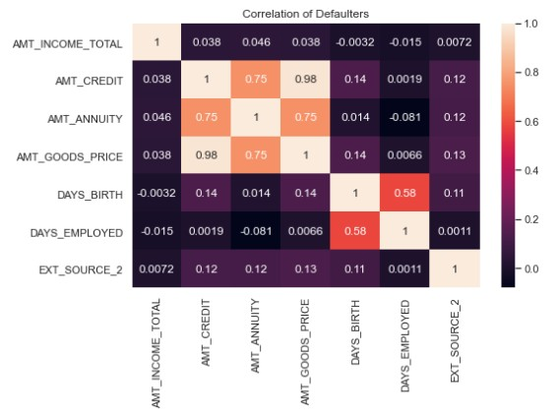
Plotting heatmap where TARGET = 1
Points to be concluded from the graph on the left.
We can see that GOODS_PRICE and AMT_CREDIT, AMT_ANNUTY
are highly correlated.
External Rating is highly correlated with all DAYS_BIRTH(Age), GOODS_PRICE, AMT_CREDIT.

Slide 27
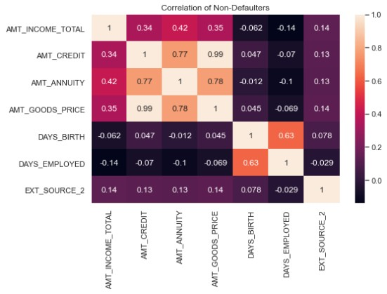
Plotting heatmap where TARGET = 0
Points to be concluded from
the graph on the left.
We can see that GOODS_PRICE and AMT_CREDIT, AMT_ANNUTY
are mederately correlated
with each other.
External Rating is highly correlated with all DAYS_BIRTH(Age), GOODS_PRICE, AMT_CREDIT.

Slide 28

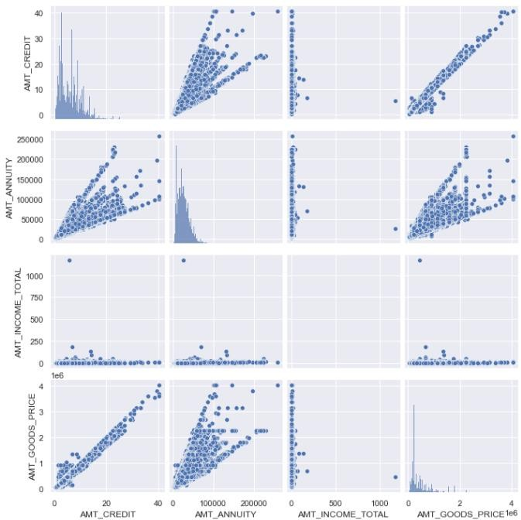
Pairplot between amount variable
(refer following slides for observation)

Slide 29
Pair Plot Observation -1
1a. AMT_CREDIT vs AMT_CREDIT : Most people are having credit amount in the range 0 to 10 and very few people have taken credit in teh range 30-40
1b. AMT_CREDIT vs AMT_ANNUITY : When credit amount is more then annuity is also increasing and there are few outliers beyong 2,00,000
1c. AMT_CREDIT vs AMT_INCOME_TOTAL : People having Income between 0 to 200 are are mostly taking credit. Ther is one outlier at 1200, but there is a less possibility that people in income range above approx 200+ are taking credit
1d. AMT_CREDIT vs AM_GOODS_PRICE : It can be inferred that as AMT_CREDIT Increases AMT_GOODS_PRICE also increases
2a. AMT_ANNUITY vs AMT_CREDIT : People in the range 0 to 100000 are taking mre credit
2b. AMT_ANNUITY vs AMT_ANNUITY : Very few people have annuity between 1.5 lac to 2.5 lac
2c. AMT_ANNUITY vs AMT_INCOME_TOTAL : Despite teh changes in annuity we can see that AMT_INCOME_TOTAL remaings constant between 0 -200 and ther is one outlier at 1200.
2d. AMT_ANNUITY vs AMT_GOODS_PRICE : As goods price increases amount annuity alos increases and there are very few outliers in this category.

Slide 30
Pair Plot Observation -2
3a. AMT_INCOME_TOTAL vs AMT_CREDIT : Amount income seems to be more concenterated fbetween 0 to 20 and further goes on decreasing after that point
3b. AMT_INCOME_TOTAL vs AMT_ANNUITY : We can see that annuity is concenterated in the range of 0 to 200000
3c. AMT_INCOME_TOTAL vs AMT_INCOME_TOTAL : No Co-relation exists here
3d. AMT_INCOME_TOTAL vs AMT_GOODS_PRICE : There is more co-relation between 0 to 2 than others
4a. AMT_GOODS_PRICE vs AMT_CREDIT : As goods price increases AMT_CREDIT also increases
4b. AMT_GOODS_PRICE vs AMT_ANNUITY : There is high concenteration of annuity between 0 to 200000, beyound that point we have outliers
4c. AMT_GOODS_PRICE vs AMT_INCOME_TOTAL : People with average Income between 0 to 200 are getting more loans
4d. AMT_GOODS_PRICE vs AMT_GOODS_PRICE : where the goods price is between 0 to 1 loan amount is higher as compared to the case when the loan amount is very less for AMT_GOODS_PRICE >1
Very high correlation between AMT_CREDIT and AMT_GOODS_PRICE - Applicants owning goods of high value can take loans of higher amounts.

Slide 31
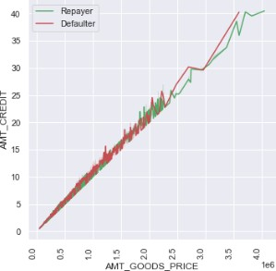
Numerical bivariate analysis
Points to be concluded from
the graph on the left.
- When the credit amount goes beyond 3M, there is an increase in defaulters.

Slide 32
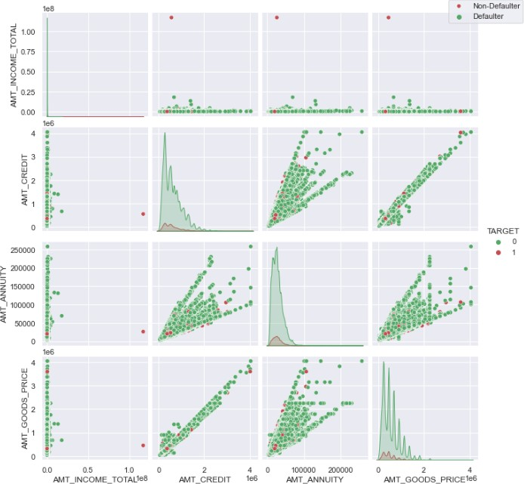
Numerical bivariate analysis
Points to be concluded from the graph on the left.
When amt_annuity >15000 amt_goods_price> 3M, there is a lesser chance of defaulters
AMT_CREDIT and AMT_GOODS_PRICE are highly correlated as based on the scatterplot where most of the data are consolidated in form of a line
There are very less defaulters for AMT_CREDIT >3M
Inferences related to distribution plot has been already mentioned in previous distplot graphs inferences section

Slide 33

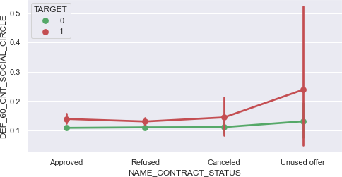
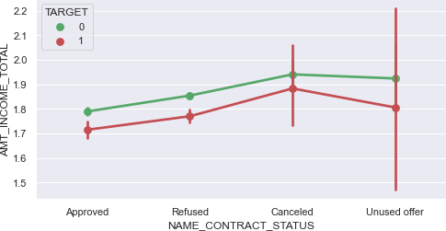
LOAN status
Points to be concluded from the graph.
The point plot show that the people who have not used offer earlier have defaulted even when there average income is higher than others
Clients who have average of 0.13 or higher DEF_60_CNT_SOCIAL_CIRCLE score tend to default more and hence client's social circle has to be analysed before providing the loan.

Slide 34
SUMMARY

Slide 35
Factors for an applicant to be Re-payer, hence applications can be approved
Applicants with Income more than 700,000 are less likely to default
Applicants with 40+ year experience having less than 1% default rate
Applicants with zero to two children tend to repay the loans.
Applicants above age of 50 have low probability of defaulting.
Student and Businessmen have no defaults.
Applicants with Trade Type 4 and 5 and Industry type 8 have defaulted less than 3%.
Loans bought for Hobby, Buying garage are being repayed mostly.

Slide 36
Factors for an applicant to be a potential Defaulter, hence application can be rejected :
When the credit amount goes beyond 3M, there is an increase in defaulters.
Male applicants have relatively higher default rate
Avoid young applicants who are in age group of 20-40 as they have higher probability of defaulting
Applicants who have less than 5 years of employment have high default rate.
Applicants in civil marriage or who are single have higher default rate
Applicants who are either at Maternity leave or Unemployed have higher default rate.
Applicants who are Low-skill Laborers, Drivers and Waiters/barmen staff, Security staff, Laborers and Cooking staff as the default rate is huge.
Organizations with highest percent of loans not repaid are Transport: type 3 (16%), Industry: type 13 (13.5%), Industry: type 8 (12.5%) and Restaurant (less than 12%). Self-employed people have relative high defaulting rate, and thus should be avoided to be approved for loan or provide loan with higher interest rate to mitigate the risk of defaulting.

Slide 37
Attributes for potential defaulters
These are those categories of people who can be considered for loan with higher interest in order to mitigate any default risk to
prevent business loss:
Applicants who get loan for 300-600k tend to default more than others and hence having higher interest specifically for this credit range would be ideal.
Since 90% of the applications have Income total less than 300,000 and they have high probability of defaulting, they could be offered loan with higher interest compared to other income category.
Applicants who have 4 to 8 children have a very high default rate and hence higher interest should be imposed on their loans.
Loan taken for the purpose of Repairs seems to have highest default rate. A very high number applications have been rejected by bank or refused by client in previous applications as well which has purpose as repair or other. This shows that purpose repair is taken as high risk by bank and either they are rejected, or bank offers very high loan interest rate which is not feasible by the clients, thus they refuse the loan. The same approach could be followed in future as well.
High number of loan applications are from the category of people who live in Rented apartments & living with parents and hence offering the loan would mitigate the loss if any of those default.

Slide 38
Conclusion
Banks should focus more on contract type ‘Student’ ,’pensioner’ and ‘Businessman’ with housing ‘type other than ‘Co-op apartment’ for successful payments.
Banks should focus less on income type ‘Working’ as they are having most number of unsuccessful
payments.
90% of the previously cancelled client have actually repayed the loan. Recording the reason for cancellation which might help the bank to determine and negotiate terms with these repaying customers in future for increase business opportunity.
88% of the clients who were refused by bank for loan earlier have now turned into a repaying client. Hence documenting the reason for rejection could mitigate the business loss and these clients could be contacted for further loans.

Slide 39
THANK YOU

